Slide 1
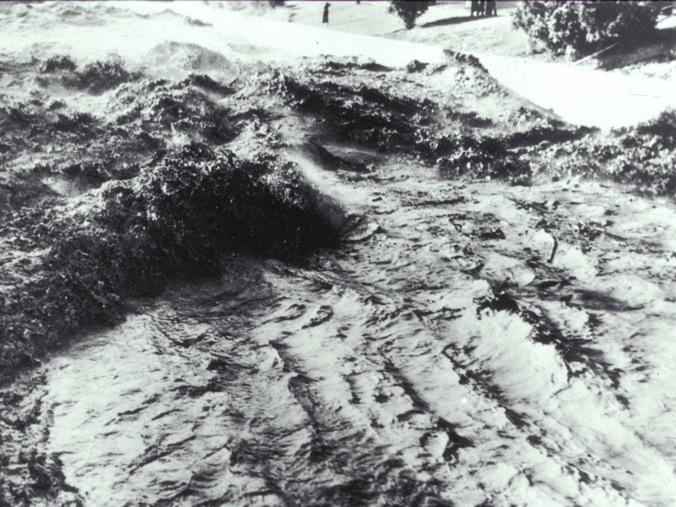
A Flash-flood Forecasting and Warning System for Urban Settings: A Proof-of-Concept Study
John Fulton
U.S. Geological Survey
Pennsylvania Water Science Center
Pittsburgh, Pennsylvania

Slide 2
Our Team
Bob Davis
Bill Drzal
John Schombert
Dr. Bill Plant
Bob Hainly
Liz Hittle
Notes:
As with any successful project, there is a cadre of good people participating and this effort is no exception.
3RWW
NWS Pittsburgh WFO
U of Washington, Applied Physics Laboratory
USGS

Slide 3
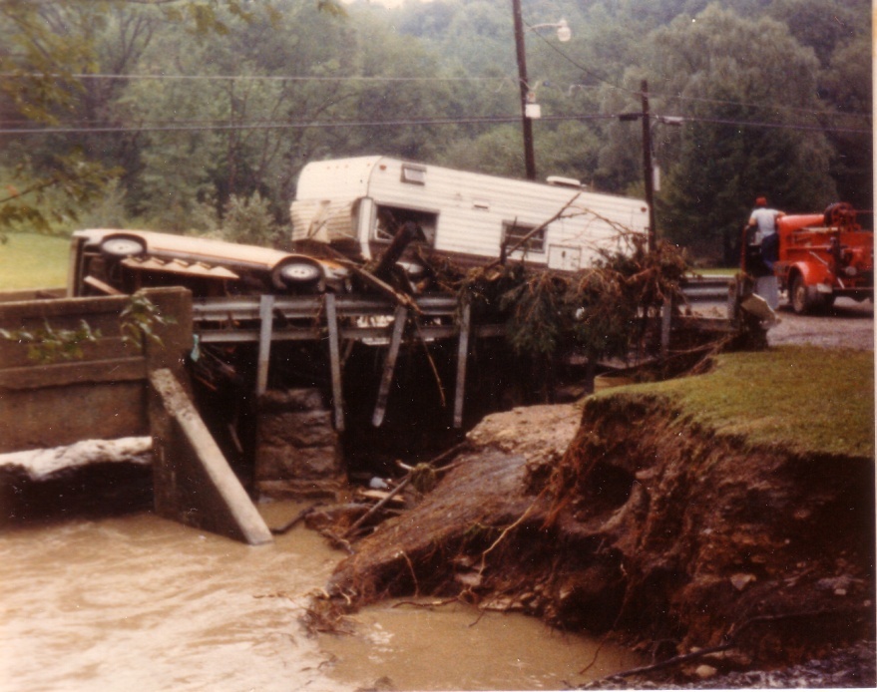
Problem Statement
Forecasting peak flows and stage in small to medium-sized watersheds (<200 mi²) can be challenging
Results can be catastrophic
Western PA has a long history of regional floods
Saint Patrick’s Day Flood (1936)
Hurricane Agnes (1972)
January flooding (1996)
Hurricanes Fran and Ivan (2004)
Localized-watershed flooding
Pine Creek Watershed (1986) resulted in nine deaths
Turtle Creek Watershed (1987) resulted in one death
Girtys Run Watershed
Notes:
Rainfall fell in about
90 minutes from
330 PM to 500 PM EDT
9 Fatalities in Little Pine Creek

Slide 4
Why Is Forecasting Problematic?
Hydrologic response to extreme-weather events is measured in minutes
Volume of water available as DRO is greater, which causes a reduction in T_{c} and an increase in the timing of peak stage
Impervious cover and reduced infiltration
Hydraulic efficiencies associated with engineered-storm controls in a sewershed
Little time for emergency management agencies and the public to respond
Notes:
August 9, 2007
Local flooding resulted in stage increases of .31 in 15 min during the onset of the storm and 5.77 feet in 15 min near the hydrograph peak.

Slide 5
The Objective
Design and implement a reliable, forecasting and warning system that relies on near-real time tools
Raingage data
Radar-rainfall data (AMBER)
Streamgages
Flood-routing models
Communication network

Slide 6
Study Area
Pine Creek Watershed
DA 67.3 mi²
Mean basin elev 1,120 ft
Adjusted basin slope 7.9
Girtys Run Watershed
DA 13.4 mi²
Mean basin elev 1,070 ft
Adjusted basin slope 9.7

Slide 7
How Do We Get There?
Task 1 Network Design and Operation
Subtask 1.1 Streamgage Siting and Installation
Subtask 1.2 Communication Network
Subtask 1.3 Thresholds and Data Transmission
Task 2 Flood-forecasting Model

Slide 8
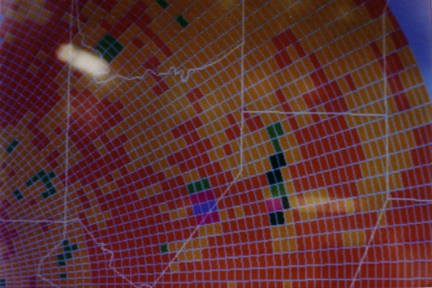
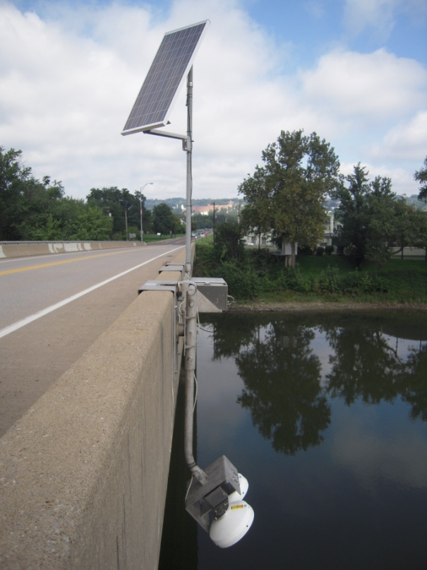
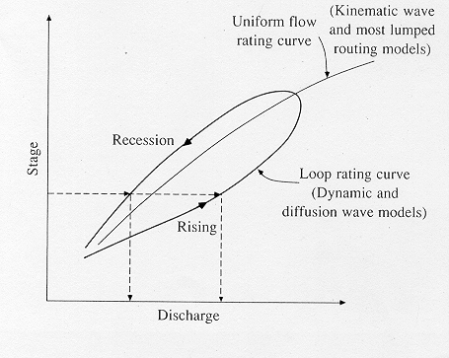
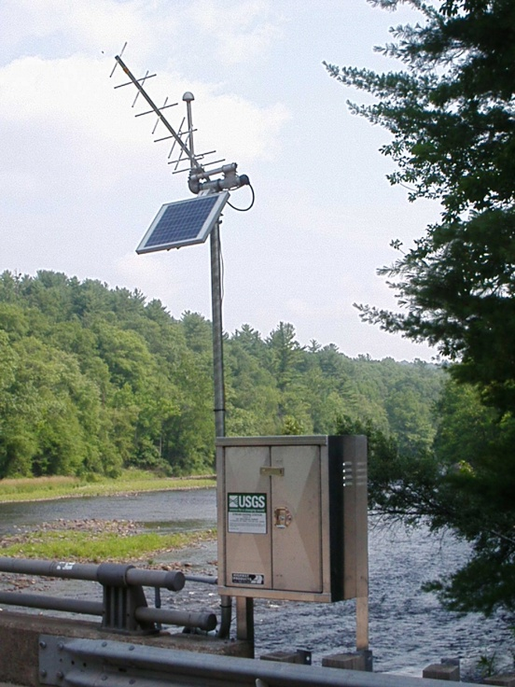
Proof-of-Concept
WSR-88
“Actual” Peak Stage and Discharge
Floodwave Routing
Surfacewater Velocity
Stage Thresholds

Slide 9
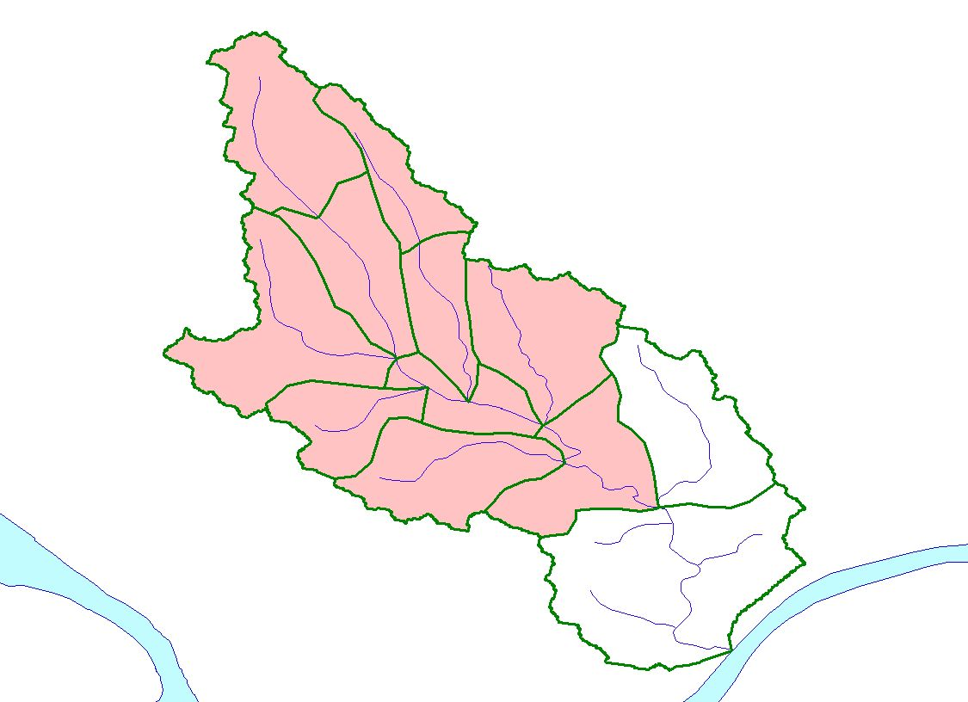
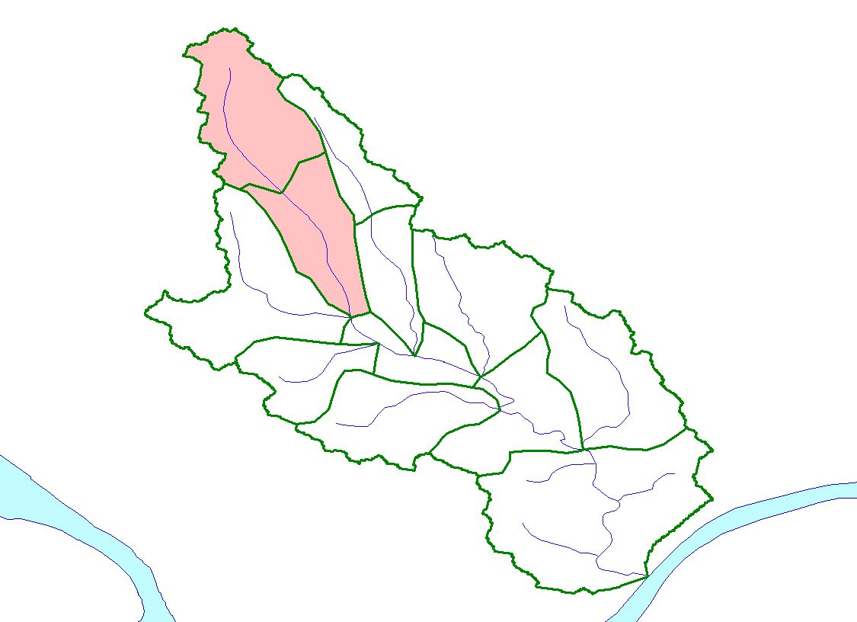
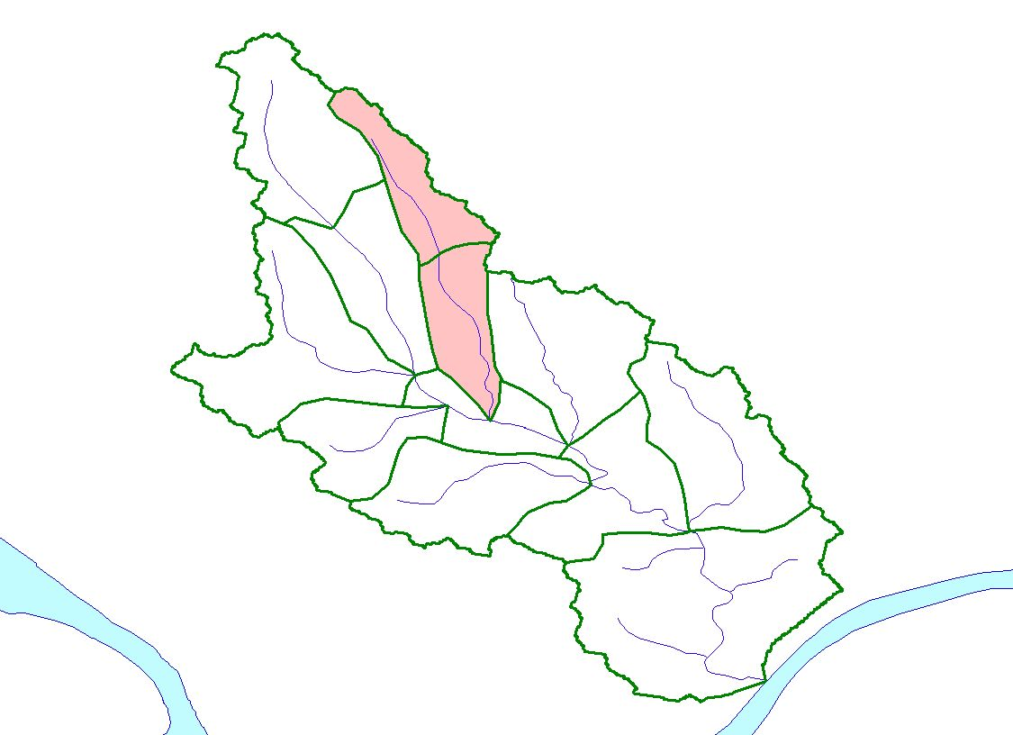
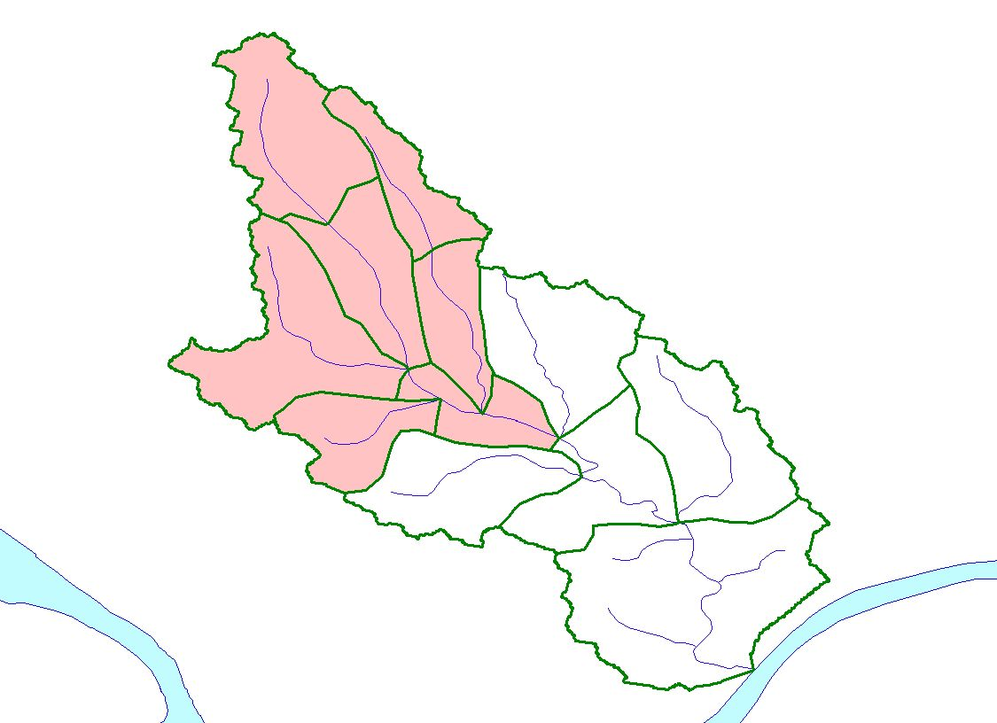
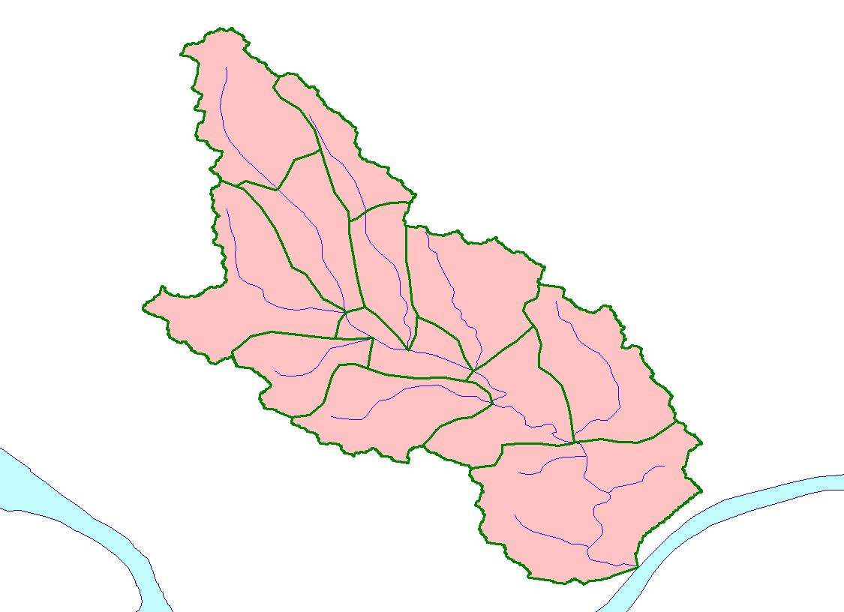
Subtask 1.1 Streamgage Siting and Installation
Identify candidate sites as a function of basin hydrology and demographics using GIS
Downstream
Tributary confluences
Impervious cover
Land type dominated by rapid-runoff
Engineered structures, drainage, sewers
Minimum T_{c}
Upstream
Contractions (bridge openings or culverts)
Backwater
Populated and frequently flooded areas
Flow-accumulation targets of 12.5, 37.5, 62.5, 87.5 percent/mi²
Each streamgaging station will include
Shelter
Non-contact, down-looking radar stage sensor
Electronic data logger
Continuous wave coherent microwave
VHF radio or satellite transmitter (GOES or Iridium network)
3621
3621
3621
3621
3621
3619
3619
3619
3619
3619
3620
3620
3620
3620
3620
3618
3614
3618
3614
3618
3614
3618
3618
3614
3617
3614
3617
3617
3617
3617
3616
3615
3616
3615
3616
3616
3616
3615
3615
3615
3611
3611
3611
3611
3612
3611
3612
3612
3612
3613
3612
3613
3613
3613
3613
3610
3610
3610
3610
3610
Ohio
River
Ohio
River
Ohio
River
Ohio
River
Ohio
River
Allegheny
River
Allegheny
River
Allegheny
River
Allegheny
River
Allegheny
River
Notes:
Prior to streamgage siting and installation, an analysis will be conducted using Geographic Information Systems (GIS) to identify candidate sites as a function of basin hydrology and demographics. Site selection will be confirmed by field visits and will focus on delivering flow and stage data from regions that offer the best information content on an impending event in the fastest time possible so that emergency managers can implement corrective measures.
Each streamgaging station will include a shelter, electronic data logger, and a transmitter. Stage will be measured using a non-contact, down-looking radar stage sensor or pressure transducer and will be transmitted via VHF radio and satellite. Streamflow will be measured at a minimum every 6-8 weeks and include low, medium, and high flows to provide calibration of the rating curve over the range of measured stages. The stage-streamflow data will be stored in the USGS-NWIS database and posted on the USGS public Web page (http://waterdata.usgs.gov/pa/nwis/rt). The USGS proposes to pilot the use of radar and computational methods to measure the surface-water velocity at selected points in the channel. A continuous-wave microwave (CW) will be fixed to a bridge and used to measure water velocities at the water surface at the bridge.

Slide 10
Subtask 1.2 Communication Network
Establish a communication network
Terrestrial –based
VHF radios
Satellite-based
GOES
Iridium network
Provide redundancy
Notes:
3RWW operates a VHF radio network of raingages in the Pine Creek and Girtys Run watersheds. The radios facilitate real-time retrievals from the existing raingage network (fig. 1) at a frequency of 174 MHz, which is compatible with NWS broadcast parameters. Communication challenges (topographic extremes, shadowing) may occur because of the location of the sensors (streamgages and raingages) in the watersheds. With minor configuration changes, the network could be modified to transmit supplemental data (see subtask 1.3) such as stage and surface-water velocity. VHF radio repeaters or additional radios may be needed to address these challenges; however, relying solely on a terrestrial-based communications system may not be prudent.
Currently all raingage and streamgage data coming into the 3Rivers network is transmitted to a DataWise computer via ALERT transmitters. Signals are received by a High Sierra Electronics ALERT receiver, passed to a High Sierra Electronics ALERT decoder and through a RS-232 serial port to the computer running the DataWise software. After DataWise receives the data, it is processed into meaningful information and distributed to the Internet.
Other communication platforms such as satellite telemetry will be piloted during this phase of the project either as a proof-of-concept or to provide redundancy in the rare event the radio network fails. Alternative infrastructures include GOES, TransCore’s GlobalWave, and Iridium networks.
To operate GOES in a reliable, low-latency, real-time manner requires using the emergency channel option. Large-scale use of this option during an extreme event may not be available on a consistent basis. GlobalWave and Iridium are U.S.-owned, commercially-available real-time satellite networks, which have operational characteristics ideal for a flood-warning system. They are capable of transmitting stage in near-real time (6 min or less) and other parameters such as flow, surface-water velocity, and stage. It is envisioned that the Iridium and GOES networks will be used during this phase of the project. The satellite-communication system installed at the streamgaging stations will send the same data that is being transmitted via the radio network to verify its performance against a known communication channel and to allow an assessment of the economics and functionality of the transmission systems.

Slide 11
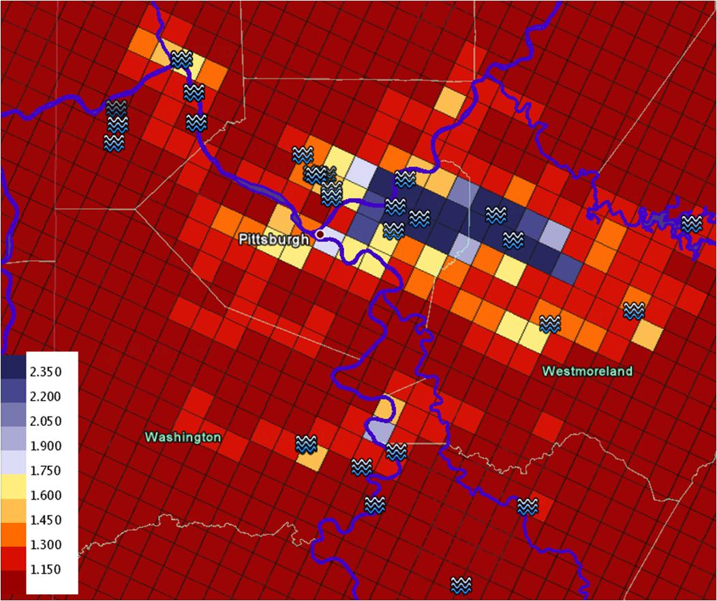
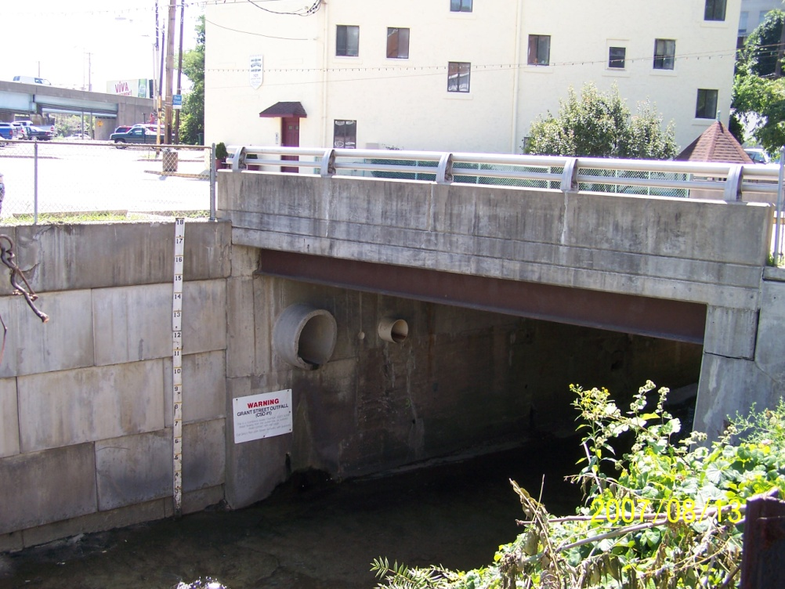
Subtask 1.3 Flash-flood Thresholds
Establish thresholds
Stage targets
25, 50, 75 percent bankfull
Radar-rainfall
Intensity, duration, frequency
Map of modeled flood frequencies (return periods)
DHM produce gridded flow forecasts from which frequency (return period) forecasts are derived using historical simulations
Threshold frequency map using local information or the 2-yr out-of-bank assumption for flash flood determination
Courtesy of Brian Cosgrove, NWS (2010)
Notes:
Typically stage and velocity data are recorded every 15 min and transmitted at intervals of 15 min to 4 hours (hr) depending on the project needs. In hydrologically-flashy, small to medium watersheds such as Pine Creek and Girtys Run, this frequency may not be sufficient to support a flood-warning system. For example, the August 9, 2007 event in Girtys Run resulted in considerable localized flooding and increases of 0.31 feet (ft) in 15 min near the onset of the storm event to 5.77 ft in 15 min near the peak of the hydrograph. The ability to sample stage at shorter time periods such as 5 min or less would have provided valuable information regarding the propagation velocity of the flood wave in the channel.
Based on estimated radar-rainfall, stage and rate-of-change thresholds, Flash Flood Warnings will be issued by the NWS WFO using normal mass media dissemination procedures. Flash Flood Warnings will be immediately available via tone-alert NOAA Weather Radio – All Hazards to decision makers, which may include emergency management officials, fire and police departments, public works departments, and elected officials. Real-time gaging-station thresholds will be monitored by the NWS WFO throughout the event. The availability of near real-time stage data would allow the inclusion of additional impact statements for increased levels of flood threat in follow-on Flash Flood Statements. In addition to mass media dissemination, Flash Flood Statements will be broadcast immediately over NOAA Weather Radio – All Hazards to better alert emergency responders to the potential magnitude and impact of the flooding.
Based on the size and historical run-off volumes in the watersheds, it is anticipated that data will be recorded and transmitted every 15 min with the proviso that during certain storm events when conditions are changing rapidly, the rate at which data is recorded and transmitted will be reduced to 5 min intervals or less. Basic data will include:
Stage (25, 50, and 75 percent-bankfull), rate-of-change in stage, and surface-water velocity (where available) from the USGS streamgaging network
Rainfall intensity/duration provided by the NWS WFO 88-D radar and 3RWWP raingage network
These data sets will be integrated and communicated to the emergency management infrastructure for the communities, which will include (1) outreach to explain the warning system and allow interested parties to sign up for automated alerts and (2) confirm the thresholds that will trigger a warning and subsequent broadcast by the NWS WFO. Other communication methods that may be used are:
Electronic bulletin boards to post warnings
Messages to local TV stations
Emergency broadcast alert system

Slide 12
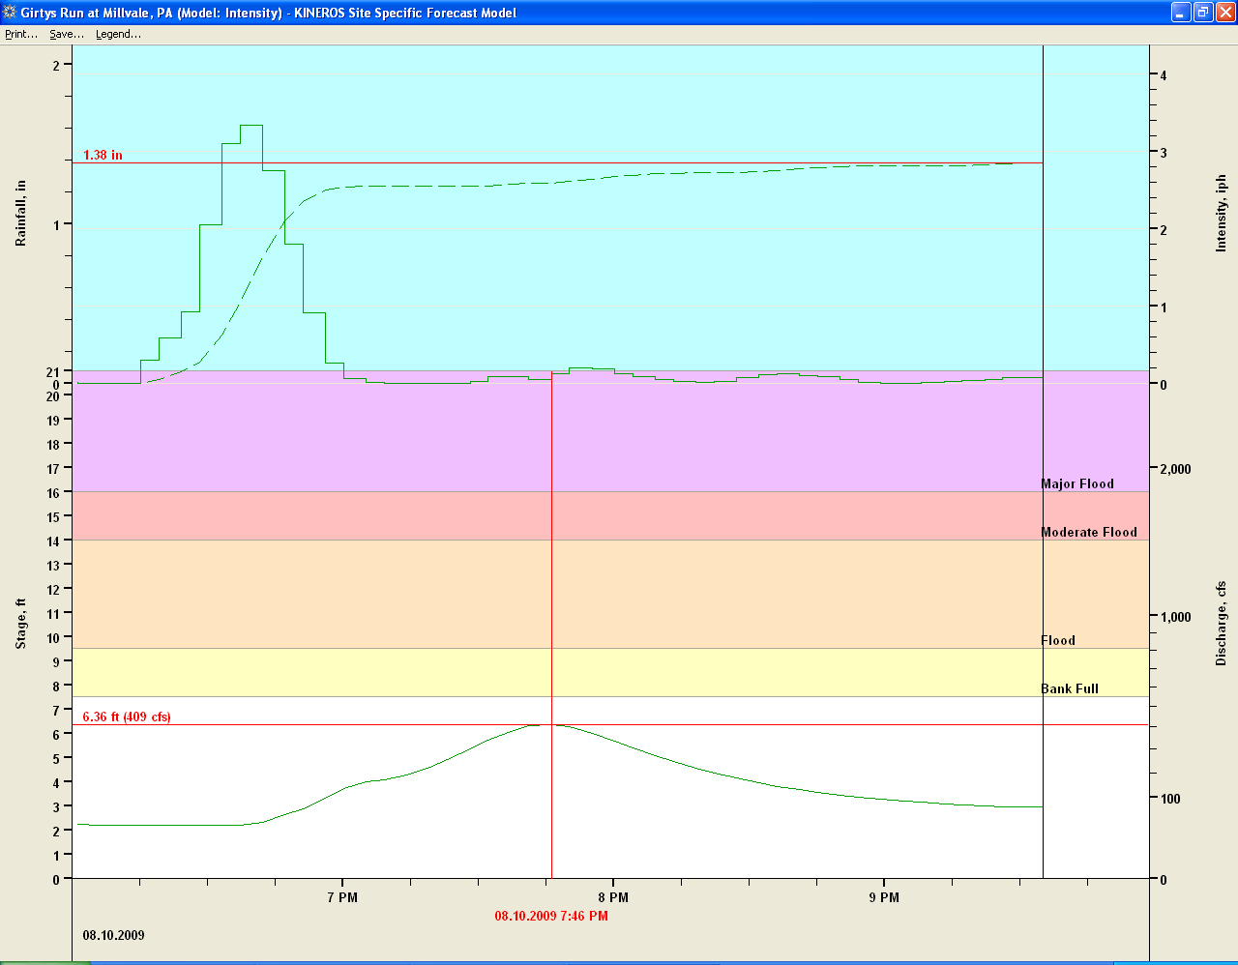
Task 2 – Flood-forecasting Model
KINEROS2
NWS Pittsburgh WFO
Preliminary results for Girtys Run are promising
Additional work is needed to address urban hydrology
Sewersheds
Culverts
Bridge openings
Courtesy of Larry Struble, NWS (2010)
Notes:
This is a case from 8/10/2009. The Stream rose just shy of bankfull that day. The measured max flow was 411 cfs at 745 pm. There was 1.32 inches of rainfall in a fairly short period of time. The simulated flow was 409 cfs at 746 pm. Changes were made to the KS and CL variables in the winconfig file to calibrate this simulated flow.

Slide 13
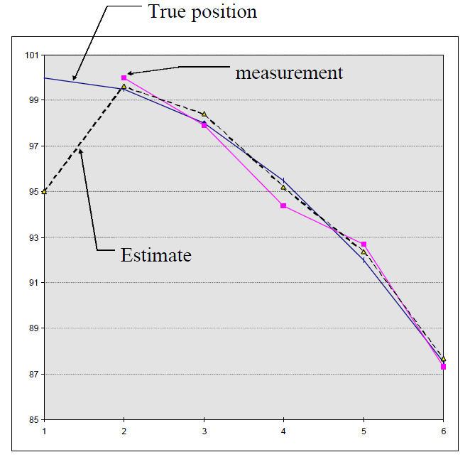
Task 2 – Flood-forecasting Model
1D hydraulic model
USGS
Ingests measured field data
Velocity and discharge
Computes discharge and stage downstream
Kalman Filter
Set of equations that provides an efficient computational (recursive) means to estimate the state of a process, in a way that minimizes the mean of the squared error
Projects the current state estimate ahead in time
Originally developed for use in spacecraft navigation

Slide 14
Continuous-wave Coherent Microwave
Equipment
Fixed-mount
Stand-alone
Reliable and accurate
Analysis
Efficient
Real-time
Accurate over a range of flows and conditions
With the proviso that data can be obtained at a single location and not require historical data

Slide 15
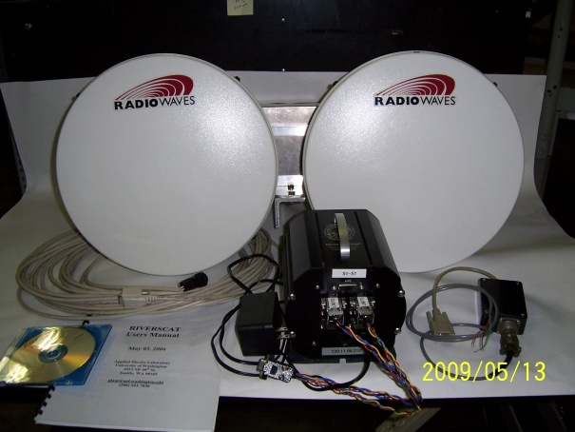
Continuous-wave Coherent Microwave
CWC Microwave (RiverScat)
Heterodyne transceiver
Bragg Scatter
14.2 GHz
Ku-band
Increased +20 dB SNR
4.5° one-way beam width
2, fixed-mount, 1-ft diameter antenna
55 amp-hr battery, 10-amp solar controller, 123-watt solar panel
Algorithm processes +/- velocities
Information Entropy
Notes:
Transmit receiver is stronger than the receiving receiver and therefore needs to be separated to avoid interferences

Slide 16
Analysis – Information Entropy
Q = φ V_{max} A
φ (M) is a measure of a streams “happy place”
Invariant to
flow
velocity
stage
channel geometry
bed form and material
slope
alignment
Does not require historical data
V_{avg} = φ V_{max}
Notes:
A significant amount of information can be derived from the maximum velocity
Under a wide-range of flow conditions, a channel section has a propensity to establish and maintain an equilibrium state that corresponds to a particular M-value and value of the expected distribution p(u/umax)
φ (M) can be explained as “happy place”
To establish an equilibrium state to maintain a particular flow, an erodible channel adjusts its characteristics including:
Bed form and material
Roughness
Shape
Slope
Alignment
Whereas, an nonerodible channel or well-established section will adjust:
Velocity distribution by modifying umax and h
e^{M} / (e^{M} – 1) – 1/M = phi

Slide 17
Results
Date | Predicted Streamflow (cfs) |  | Calculated Streamflow (cfs) | Percent Difference (%)
 | φ Based on Historical Data | φ Based on June 2002 Visit |  | φ Based on Historical Data | φ Based on June 2002 Visit
06/27/2002 | 10,350 | 10,200 | 10,130 ^{b} | 2.1 | 0.5
07/01/2006 | 152,100 | 150,100 | 151,000 ª | 0.7 | -0.6
11/21/2006 | 49,580 | 48,930 | 49,180 ^{b} | 0.8 | -0.5
Notes:
06/27 ud = na and 2.3 fps
07/01 ud = 8 and 8 fps
11/21 ud = na and 5.2 fps

Slide 18
Questions/Comments/Barbs?
Collaborators:
3 Rivers Wet Weather
National Weather Service WFO, Pittsburgh, PA
University of Washington, Applied Physics Laboratory

